Slide 1
Jet-Finance: Predictive Analysis Telegram Bot with Bidirectional LSTM
Under the guidance of Professor,
Len Mancini.
Submitted By:
Saathyak R. Kasuganti
UMBC ID: FV86010

Slide 2
Presentation Agenda:
Problem Statement
Motivation
Tools and modules used.
Data description
Model Architecture
Results - Analysis.
Challenges.
Learning / Recommendations.

Slide 3
Problem Statement:
Problem Type: Stock price – trend predictor
Domain: Finance.
Hypothesis: The use of a telegram bot that uses a bi-directional LSTM, can very efficiently and conveniently predict the stock price trend for any given stock symbol.
Target Audience: Anybody with a smartphone/computer and has access to telegram application.

Slide 4
Motivation:
Resource limitations: Simplicity is the key.
Wait times for Bot’s result: Inference time restrictions for a bot based model.
Variation of patterns for various stocks : pre-training the model vs training it with limited epochs.
Versatility of bi-directional LSTM models to be able to :
Capture long-term dependencies.
Contextual understanding – processing input forward and backwards.
Improved prediction accuracy.
Flexibility of predicting over multiple time horizons.

Slide 5
Tools / Modules Used:
Telegram - To interact with Telegram API and use bot.
Pandas – Data analytics tools
NumPy – Numerical library with math. functions.
Yfinance – Library to use Yahoo Finance API
Sklearn – For ML Models.
Tensorflow – Used for LSTM model and Dense layers.
Matplotlib – For visualizing the stock price and generate the graphs.

Slide 6
Data Description
Training data is considered for a period of 1 Year and 4 months.
Training data dates : January 2022 to May 2023.
Considering the LSTM model’s complexity
If time period is too low, the model may not generalize well.
Therefore it should be at-least an year long for ideal model training
If time period is too long, the model’s training time is drastically increased.
If the time period is around is around 6-7 years, the bi-directional LSTM takes too much time to train the model and generate the prediction results.

Slide 7
Model : Bi-Directional LSTM
Consists of two LSTMs: One processes input in the forward direction, while the other processes it in the backward direction.
BiLSTMs enhance context by considering both preceding and succeeding elements in a sequence.
Forward pass: Input sequence is processed from beginning to end in the forward LSTM layer, updating memory cells and generating hidden states.
Backward pass: Input sequence is processed from end to beginning in the backward LSTM layer, updating memory cells and generating hidden states.
Hidden state combination: Hidden states from both directions are combined to leverage information from the past and future context.
Enhanced context understanding: BiLSTMs capture long-term dependencies and improve understanding of sequential data by considering preceding and succeeding elements.

Slide 8
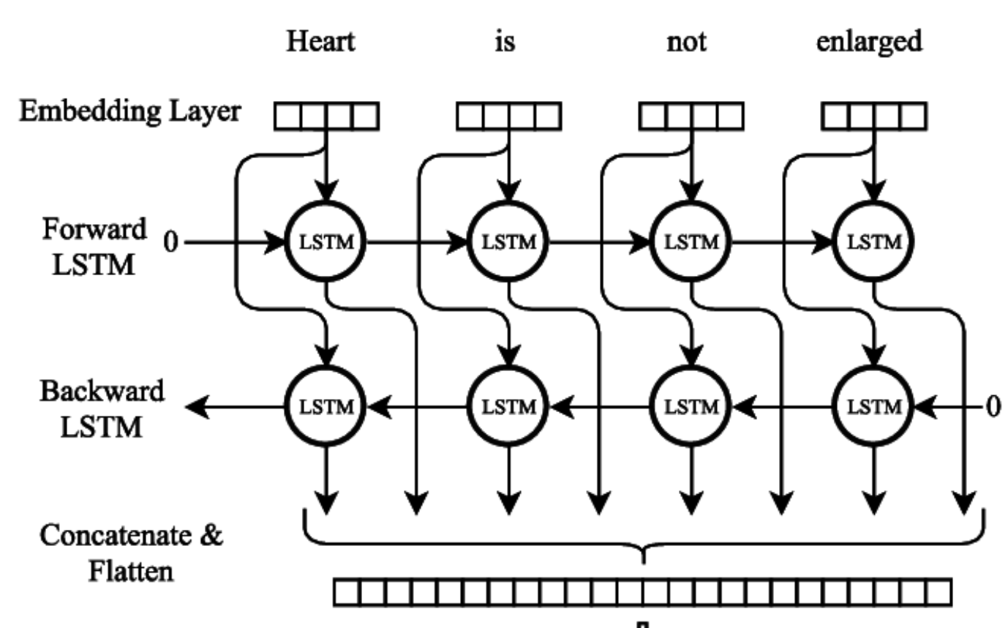
Model : Bi-Directional LSTM

Slide 9
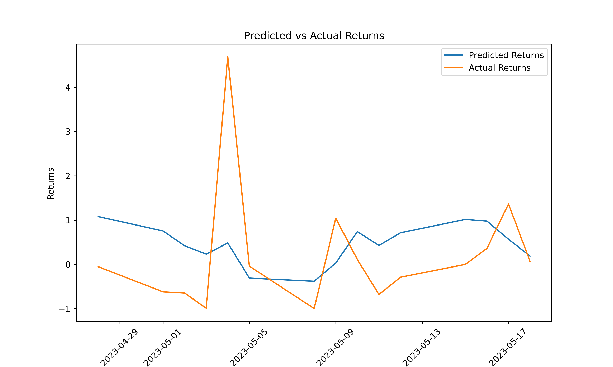
Model : Trend Prediction Apple

Slide 10
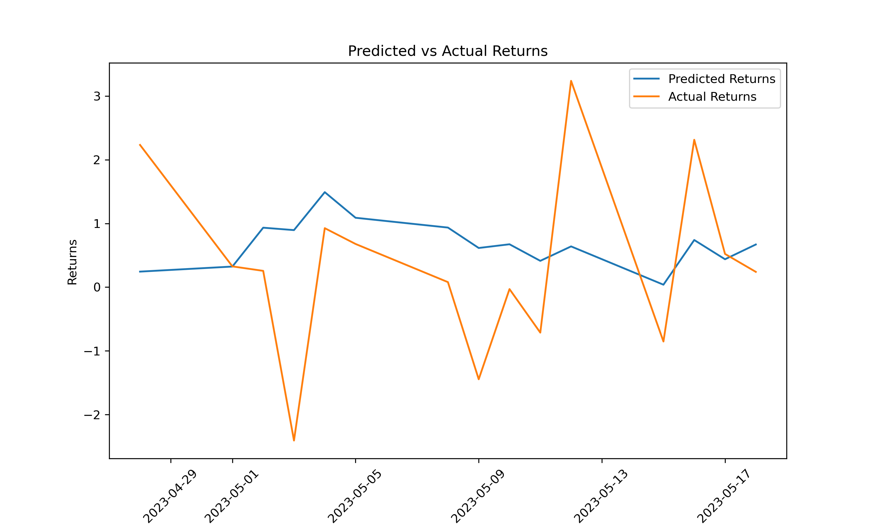
Model : Trend Prediction GE

Slide 11
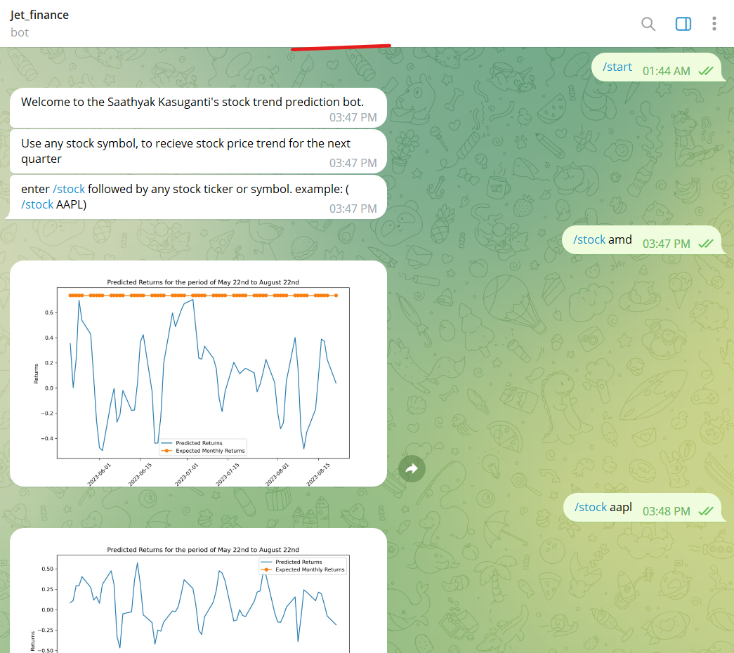
Model : Trend Prediction Results

Slide 12
Learning and Recommendations
Select models based on type of execution and environment.
Accuracy vs Responsiveness trade-off.
Consider available hardware resources.
Occam's Razor. Among two similarly performing algorithms, select one that is least complex.
Make sure the code is optimized.
Its critical to use debugging techniques and error handling methods.

Slide 13
THANK YOU
References:
https://paperswithcode.com/method/bilstm

